Slide 1
Respiratory Diseases

Slide 2
Objective:
Understand how disease can compromise the respiratory system

Slide 3
Prior Knowledge
What is a disease?
What to you know about respiratory diseases.
Make a list of respiratory diseases.

Slide 4
Research – Respiratory Diseases
In pairs students will use a computer and write a summary of a selected respiratory disease.
They will present their findings to the class.
List of Diseases:
Mesothelioma
Asthma
Pneumonia
Bronchitis
Tuberculosis

Slide 5
Research – Respiratory Diseases,
Describe the disease
What is the source of the disease.
Which part(s) of the respiratory system is / are affected?
Explain the role of this / these part(s) of the respiratory system?
How does their function / structure change if a person has this disease?
How can the disease be treated

Slide 6
5 minute presentations

Slide 9
Diseases of the respiratory system
Use the human perspectives text to research the following:
Asthma
Emphysema
Lung cancer
Pneumonia
Topics to research include: cause, symptoms and treatment

Slide 10
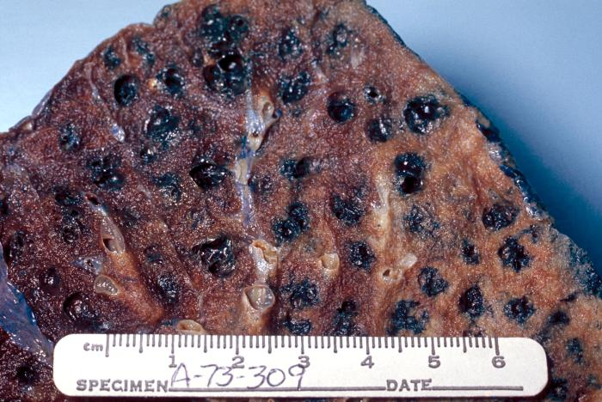
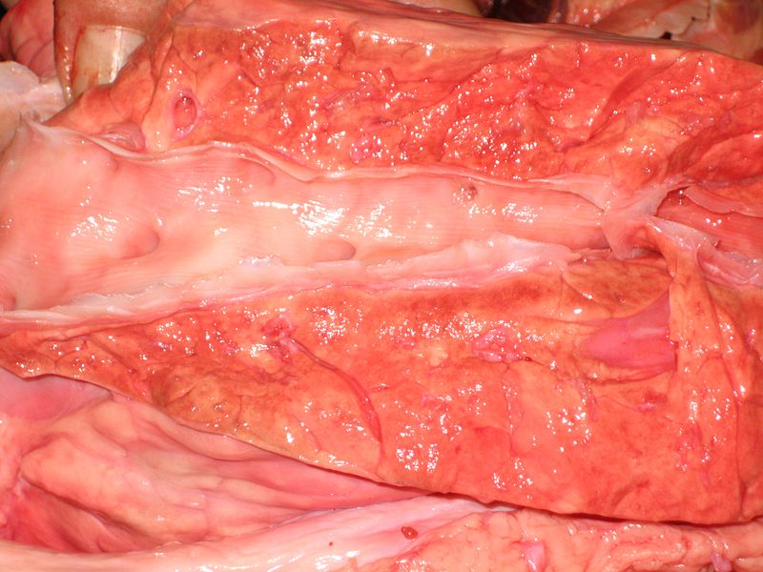
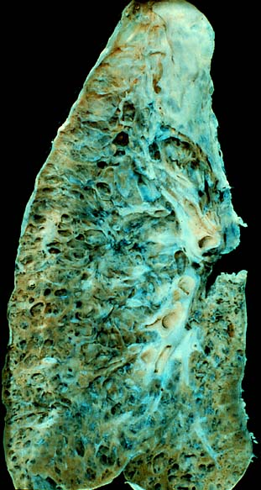
Diseased lung tissue
B
A
CDC
C
healthy lung tissue
Smoker’s lung
Emphysema
Photo by Pöllö

